Slide 1
Outline
Review: study of the PFC deadlock caused by routing loop
Necessary conditions for PFC deadlock creation
Proof: in clos network no PFC deadlocks can be created when only shortest paths are used

Slide 2
Outline
Review: study of the PFC deadlock caused by routing loop
Necessary condition for PFC deadlock creation
Proof: in clos network no PFC deadlocks can be created when only shortest paths are used

Slide 3
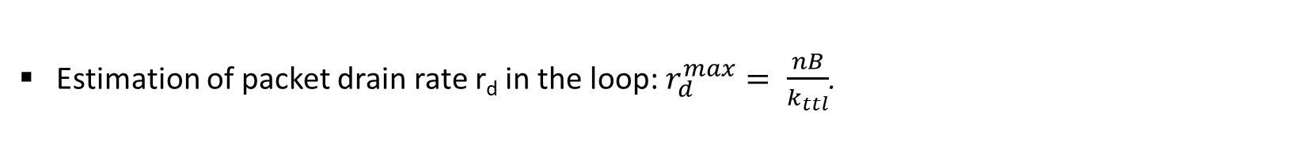
Review: study of the PFC deadlock caused by routing loop
Estimation of packet drain rate r_{d} in the loop: $r_{d}^{max}= \frac{nB}{k_{ttl}}$.

Slide 4
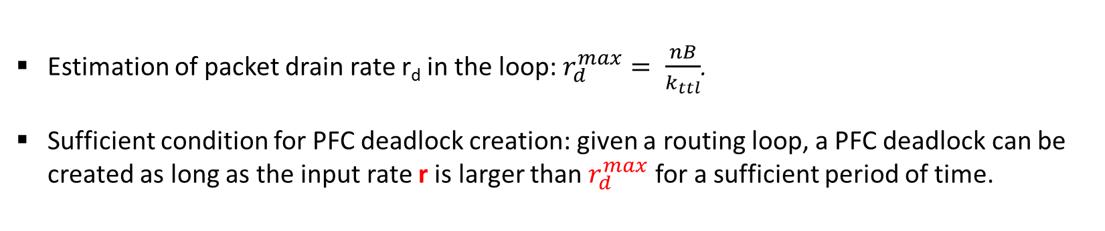
Review: study of the PFC deadlock caused by routing loop
Estimation of packet drain rate r_{d} in the loop: $r_{d}^{max}= \frac{nB}{k_{ttl}}$.
Sufficient condition for PFC deadlock creation: given a routing loop, a PFC deadlock can be created as long as the input rate r is larger than $r_{d}^{max}$ for a sufficient period of time.

Slide 5
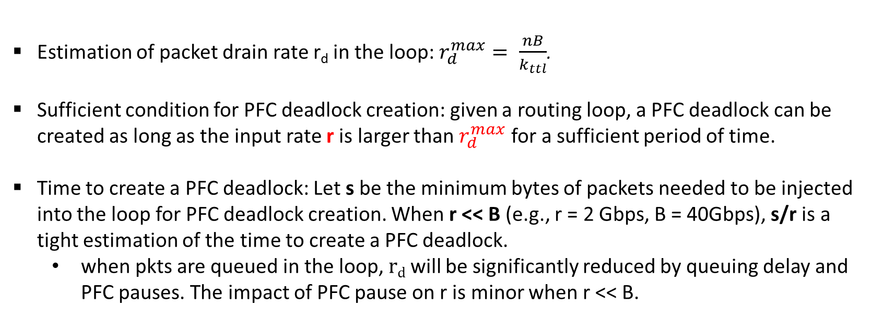
Review: study of the PFC deadlock caused by routing loop
Estimation of packet drain rate r_{d} in the loop: $r_{d}^{max}= \frac{nB}{k_{ttl}}$.
Sufficient condition for PFC deadlock creation: given a routing loop, a PFC deadlock can be created as long as the input rate r is larger than $r_{d}^{max}$ for a sufficient period of time.
Time to create a PFC deadlock: Let s be the minimum bytes of packets needed to be injected into the loop for PFC deadlock creation. When r << B (e.g., r = 2 Gbps, B = 40Gbps), s/r is a tight estimation of the time to create a PFC deadlock.
when pkts are queued in the loop, $r﷮d$ will be significantly reduced by queuing delay and PFC pauses. The impact of PFC pause on r is minor when r << B.

Slide 6
Outline
Review: study of the PFC deadlock caused by routing loop
Necessary condition for PFC deadlock creation
Proof: in clos network no PFC deadlocks can be created when only shortest paths are used

Slide 7
Necessary conditions to permanently hold a PFC deadlock
S1
S2
tx
rx
rx
tx
tx
rx
S4
S3
rx
tx
Packet forward direction
PFC pause direction
Two necessary conditions for a PFC deadlock to permanently hold:
PFC pause frames form a loop;
All the packets received by the ingress queue are forwarded to the paused egress queue (or next hop in the loop).

Slide 8
Flow requirement for PFC deadlock creation
We want to find a flow distribution which is possible to create a PFC deadlock among S1, S2, S3 and S4:
Flow 2: S2 -> S3
Flow 1: S1 -> S2
S1
S2
rx
rx
rx
S4
rx
S3
Flow 3: S3 -> S4
Flow 4: S4 -> S1
Case 1: All the four flows only traverse 2 consecutive switches in the loop. In this case, no switch can be permanently paused by any flows.

Slide 9
Flow requirement for PFC deadlock creation
We want to find a flow distribution which is possible to create a PFC deadlock among S1, S2, S3 and S4:
Flow 2: S2 -> S3 -> S4
Flow 1: S1 -> S2 -> S3
S1
S2
S4
S3
Flow 3: S3 -> S4 -> S1
Flow 4: S4 -> S1 -> S2
Flow direction
PFC pause direction
Case 2: All the flows traverse 3 consecutive switches in the loop. In this case, each flow is possible to permanently paused the first switch it traverses.
*Given this flow distribution, it is not guaranteed that a PFC deadlock can occur.

Slide 10
Flow requirement for PFC deadlock creation
We want to find a flow distribution which is possible to create a PFC deadlock among S1, S2, S3 and S4:
Flow 1: S1 -> S2 -> S3
S1
S2
S4
S3
Flow 2: S3 -> S4 -> S1 -> S2
Flow direction
PFC pause direction
Case 3: All the flows traverse 4 consecutive switches in the loop. In this case, each flow is possible to permanently paused the first two switch it traverses.
*Given this flow distribution, it is not guaranteed that a PFC deadlock can occur.

Slide 11
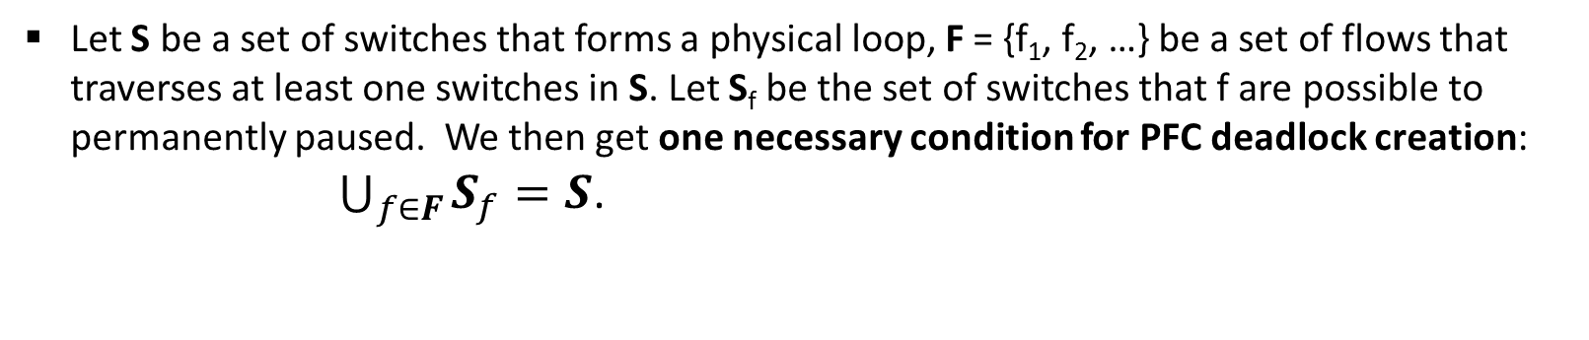
Necessary condition for PFC deadlock creation
Theorem-1: A flow traversing k (k>2) consecutive switches in the loop are only possible to permanently pause the first k-2 switches. A flow traversing 2 or less consecutive switches in the loop cannot permanently pause any switches in the loop.
Let S be a set of switches that forms a physical loop, F = {f₁, f₂, …} be a set of flows that traverses at least one switches in S. Let S_{f} be the set of switches that f are possible to permanently paused. We then get one necessary condition for PFC deadlock creation:
$\bigcup_{f∈F}{S_{f}=S}$.

Slide 12
Outline
Review: study of the PFC deadlock caused by routing loop
Necessary condition for PFC deadlock creation
Proof: in clos network no PFC deadlocks can be created when only shortest paths are used

Slide 13
No PFC deadlocks in clos network
when only shortest paths are used
A shortest path in a clos network:
s_{k}
Level m
…
…
s₂
S_{n-1}
Level 2
s₁
s_{n}
Level 1
Let p be a path in a clos network, l_{k} be the level number of switch k in the topology, and s₁, s₂, …, s_{n} be the sequence of switches that path p traverses.
If we assume that there is no peer link in clos network, we have:
Theorem-2: Let s_{k} be one highest-level switch that path p can traverse. If p is a shortest path, then we have l_{s1} < l_{s2} < … < l_{Sk} and l_{sk} > ls_{k+1} > … > l_{Sn}.

Slide 14
No PFC deadlocks in clos network
when only shortest paths are used
s_{k}
…
…
s₂
s_{n}
s₁
Flow direction
PFC pause direction
Proof: Assuming that in a clos network, it is possible to create a PFC deadlock among switches s₁, s₂, …, s_{n} with a set of flows that are routed over shortest paths.
Without loss of generality, we assume s₁ is a switch in the lowest level. According to theorem 1, in order to pause switch s_{n}, we at least need a flow (denoted as f₁) to traverse s_{n} -> s₁ -> s₂. According to theorem 2, flow f1 does not traverse a shortest path. This violate the assumption that all the flows are routed over shortest path.

Slide 15
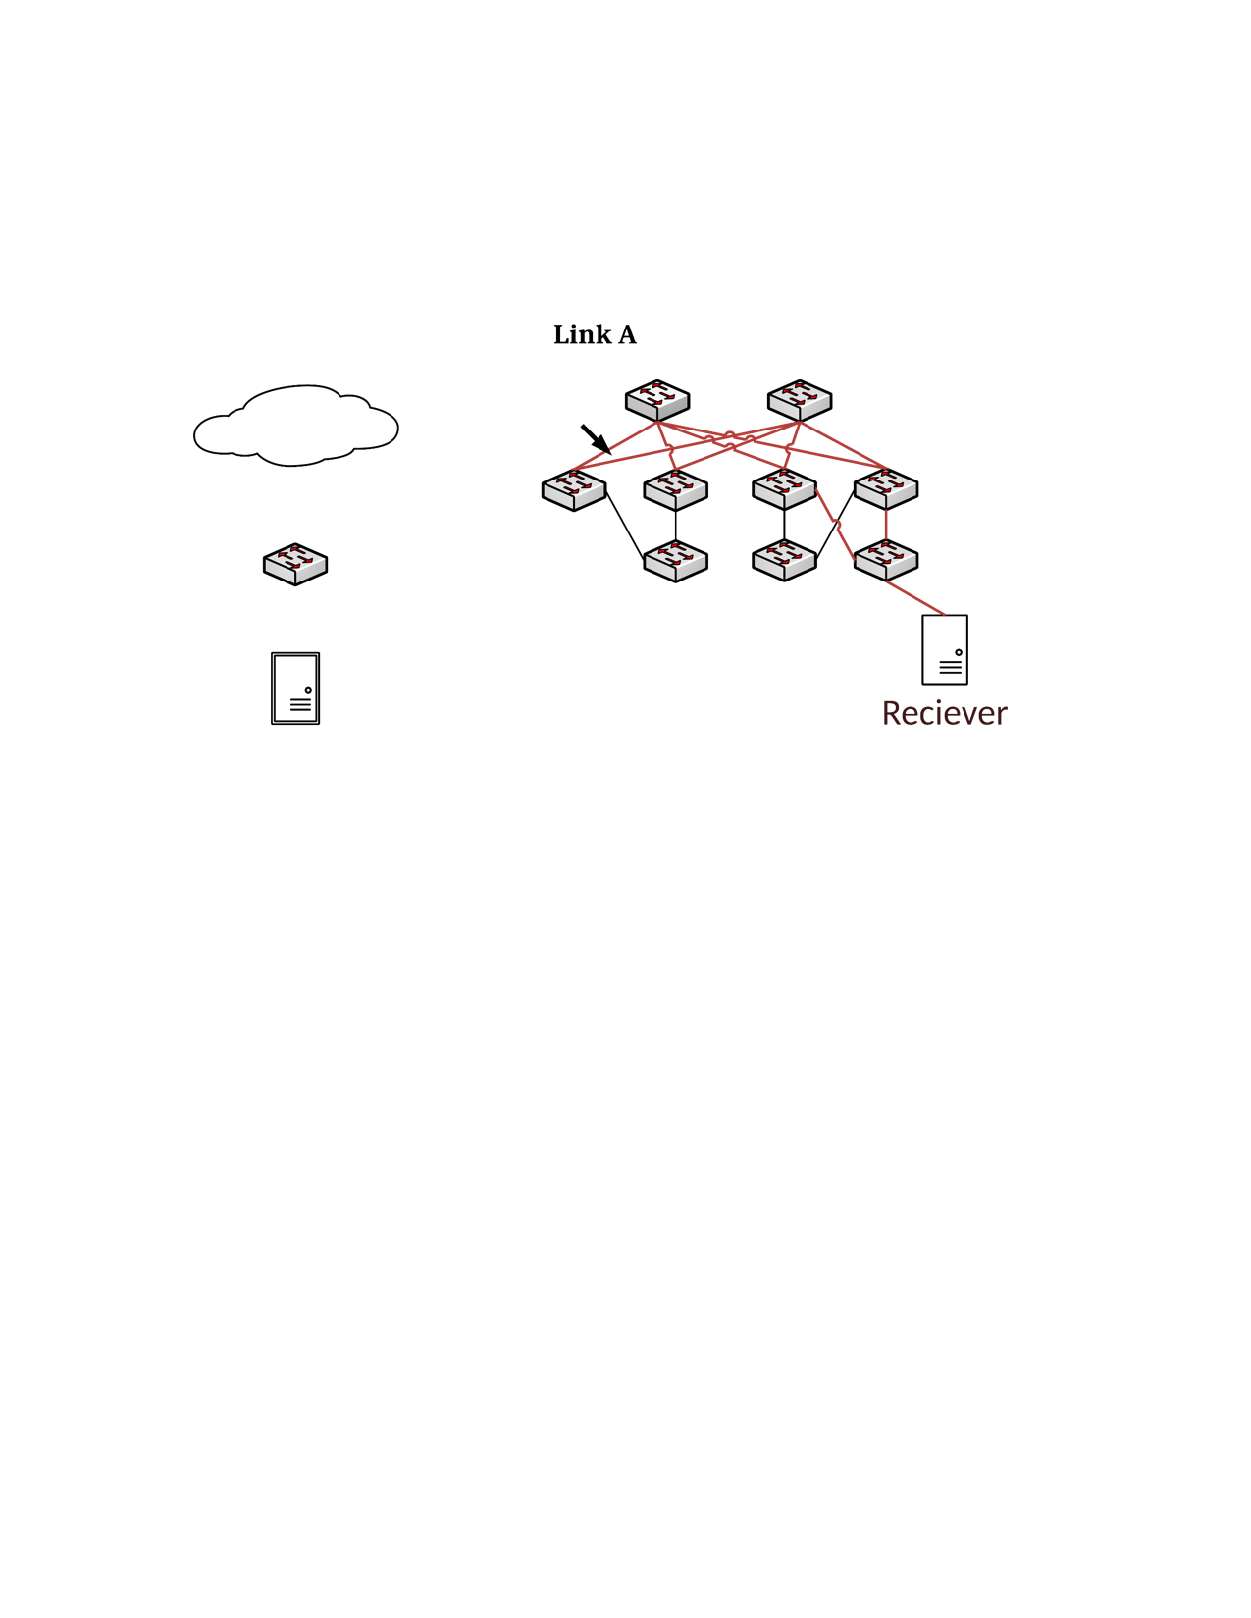
A possible PFC deadlock case caused by link repair
Core 1
Core 2
Flow 1
Flow 2
Aggr 1
Aggr 2
Aggr 3
Aggr 4
ToR 1
ToR 2
ToR 3
ToR 4
H1: 10.0.0.1
H2: 10.0.1.1
H3: 10.1.0.1
H4: 10.1.1.1

Slide 16
A possible PFC deadlock case caused by link repair
C1
C2
A2
A3
Flow direction
PFC pause direction
Flow 1: A3 -> C2 -> A2 -> C1. A3 and C2 can be paused by it when A2 is already paused.
Flow 2: A2 -> C1 -> A3 -> C2. A2 and C1 can be paused by it when A3 is already paused.

